Slide 1

Challenge 7
Group 5
Shu, Dave, Ray, Aaron, Shen

Slide 2

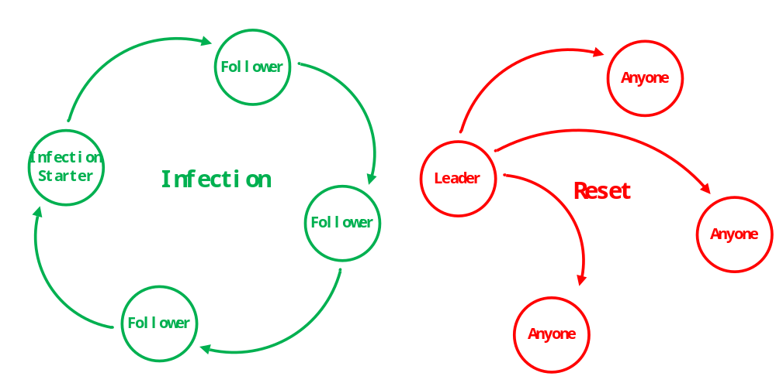
Workflow Overview

Slide 3
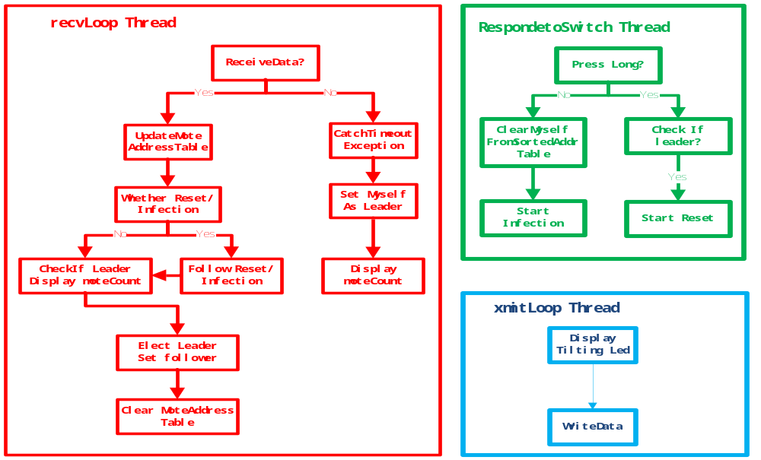
Threads Architecture

Slide 4
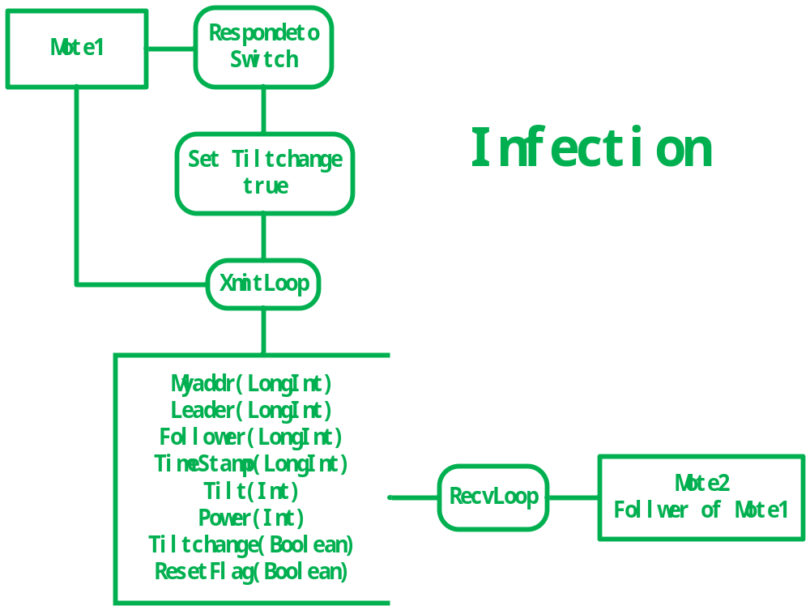
Data Flow

Slide 5
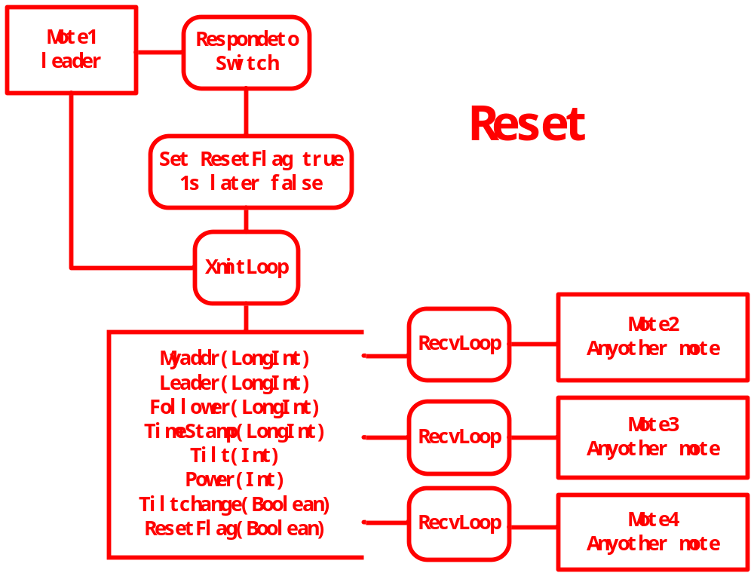
Data Flow

Slide 6
Demonstration
See Spots.

